Slide 1
Lecture 7-2
Application & Tips:
Learning and test data sets
Sung Kim <hunkim+mr@gmail.com>
http://hunkim.github.io/ml/

Slide 2
Performance evaluation: is this good?

Slide 3
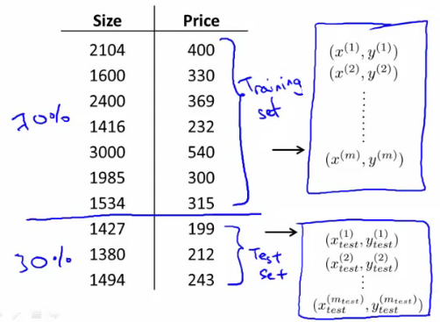
Evaluation using training set?
100% correct (accuracy)
Can memorize

Slide 4
Training and test sets
http://www.holehouse.org/mlclass/10_Advice_for_applying_machine_learning.html

Slide 5
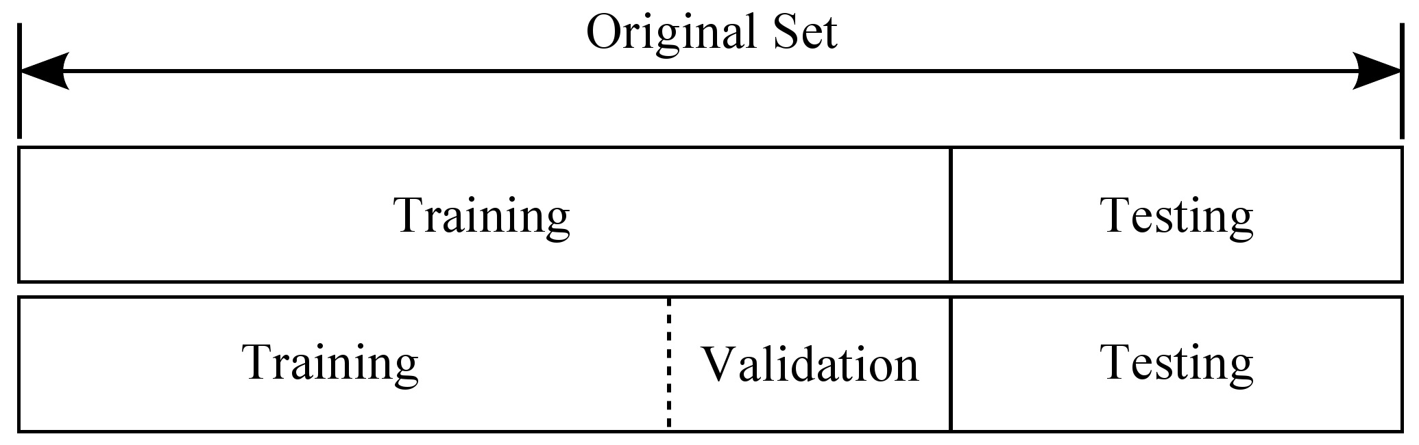
Training, validation and test sets
http://www.intechopen.com/books/advances-in-data-mining-knowledge-discovery-and-applications/selecting-representative-data-sets

Slide 6

Online learning
model
http://www.intechopen.com/books/advances-in-data-mining-knowledge-discovery-and-applications/selecting-representative-data-sets

Slide 7
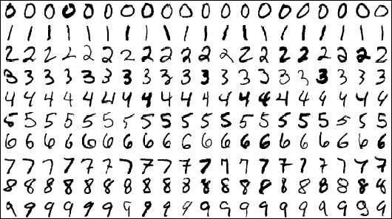
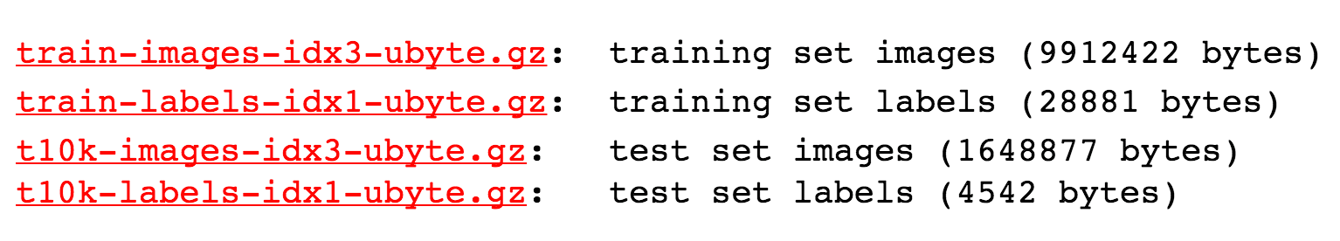
MNIST Dataset
http://yann.lecun.com/exdb/mnist/

Slide 8

Accuracy
How many of your predictions are correct?
95% ~ 99%?
Check out the lab video

Slide 9

Next
Deep Neural Nets!

